Slide 1
Film Types(Vocabulary)
VIOL

Slide 2

Action Movie

Slide 3
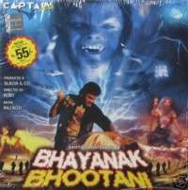
Horror Movie

Slide 4
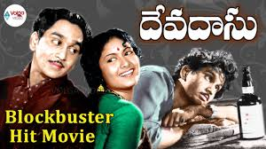
Tragedy Film/Tear Jerker

Slide 5

Mythological Movies

Slide 6
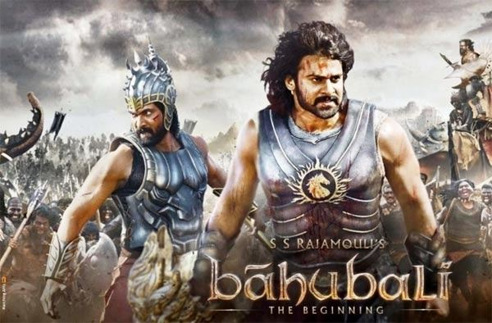
Period Film

Slide 7

Biopic Film

Slide 8

Sentimental Film

Slide 9
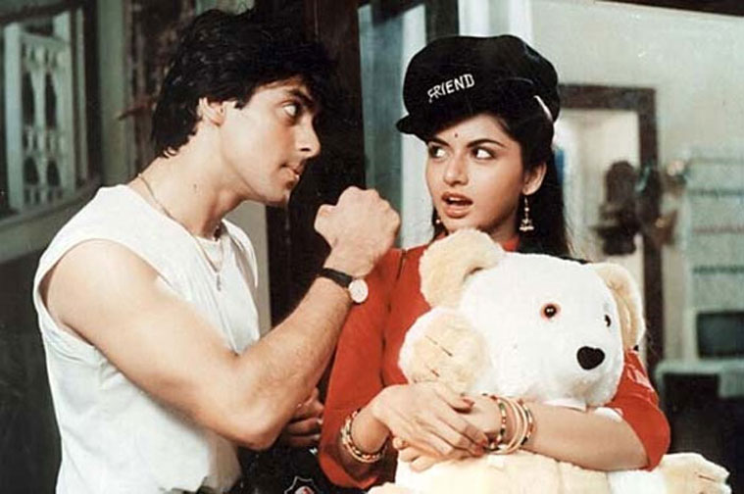
Romantic Film

Slide 10

Fantasy Film

Slide 11
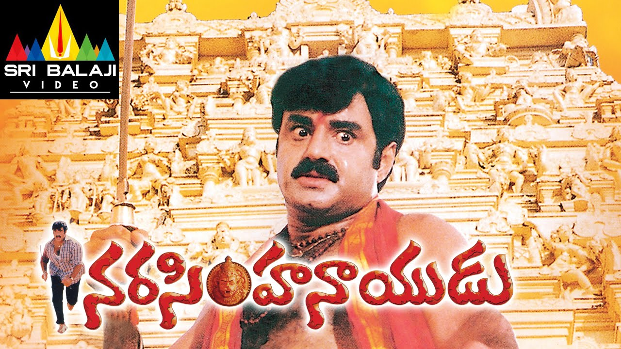
Melodramatic Film

Slide 12
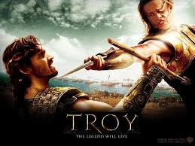
Epic/Historical Movie

Slide 13
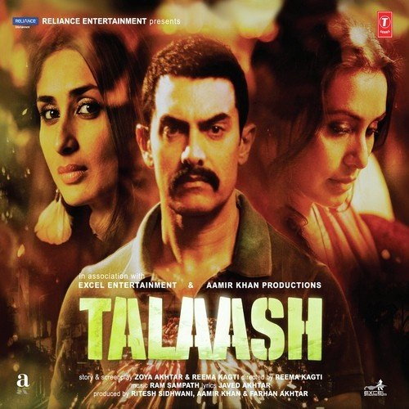
Suspense Thriller/Mystery Film

Slide 14
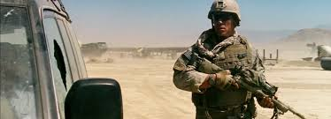
War Movie

Slide 15
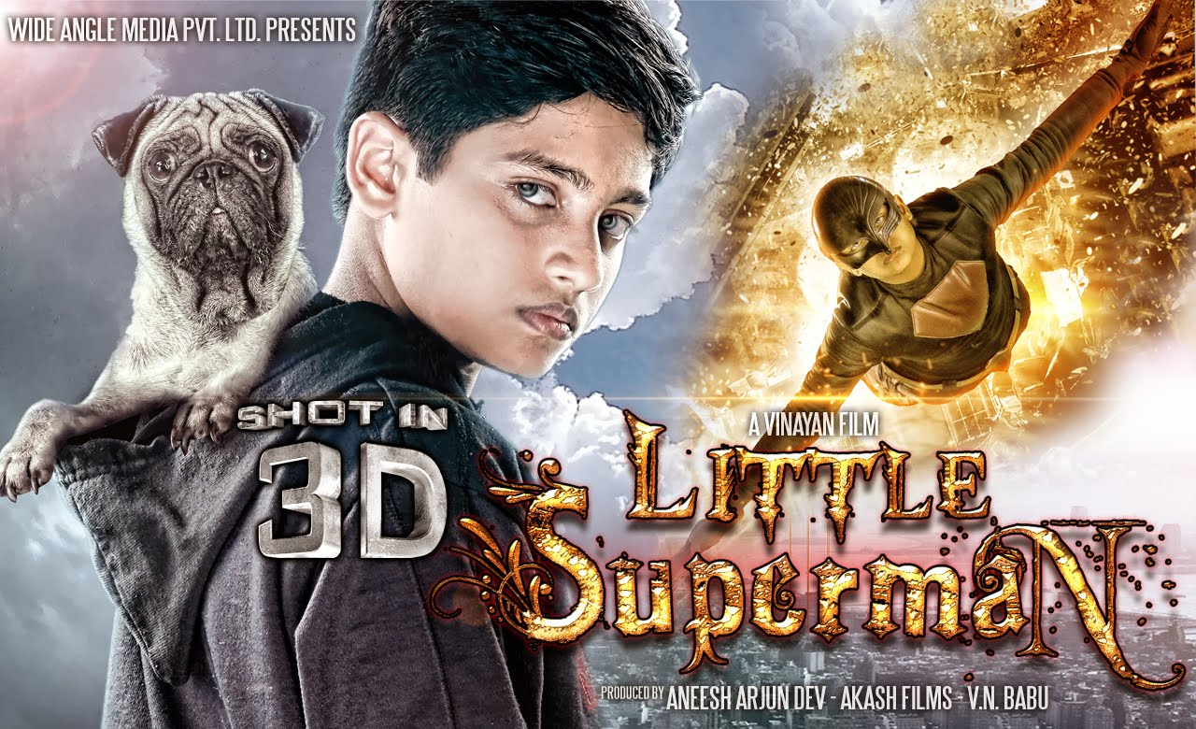
Supernatural Movie

Slide 16

Crime and Gangster Film

Slide 17

Cowboy Movie

Slide 18

Family Entertainer

Slide 19
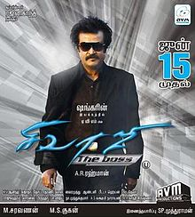
Extravaganza

Slide 20
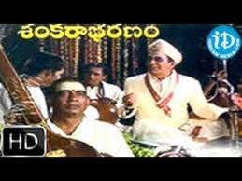
Musical Film

Slide 21

Adventure Film

Slide 22

Silent Movie

Slide 23

Patriotic Film

Slide 24
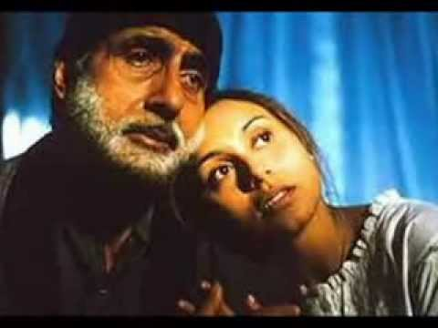
Off beat Film

Slide 25
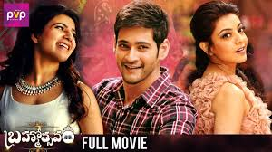
Run of the Mill(routine)

Slide 26

Classic Movie

Slide 27

Evergreen Movie

Slide 28
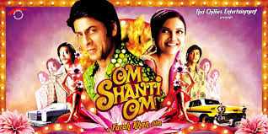
Multistarrer/ Blockbuster

Slide 29

Scifi Movie

